Slide 1
OPERATION ANALYTICS AND INVESTIGATING METRIC SPIKE
- By Diksha Ausekar

Slide 2

AGENDA:
PROJECT DESCRIPTION
APPROACH
TECH-STACK USED
INSIGHTS
RESULTS
CONCLUSION

Slide 3
PROJECT DESCRIPTION:
Operation Analytics involves analyzing all aspects of a company's operations from start to finish. This analysis helps the company identify areas for improvement. I have collaborated with the operations, support, and marketing teams to extract valuable insights from the data they collect. This methodical methodology acts as a guide for predicting the general course of a business's growth or decline. Its ability to direct strategic choices and promote sustainable growth accounts for its importance.
Investigating metric spikes is crucial in operation analytics. As a Data Analyst, I've helped teams understand fluctuations in metrics like daily engagement and sales, answering questions such as why there's a dip in engagement or sales. It's essential to investigate spikes daily to ensure accurate insights and proactive decision-making.

Slide 4

APPROACH:
STEP 1 : Creation of database and table
- Created database
- Created tables using defined structures and links.
STEP 2 : SQL analysis
- Analyze the data set with SQL.
- Created tables to calculate different queries.
STEP 3 : Data Aggregation and Structuring
- Combined bits of data to structure tables for understanding.
- Obtained results needed to make decisions.
STEP 4 : Insight Generation
- generated statistics for informed decisions.

Slide 5

TECH-STACK USED:
My SQL Community Server 8.0(for executing sql queries)
Microsoft Excel-(for import and export of datasets files)
Microsoft powerpoint-(for ppt)

Slide 6
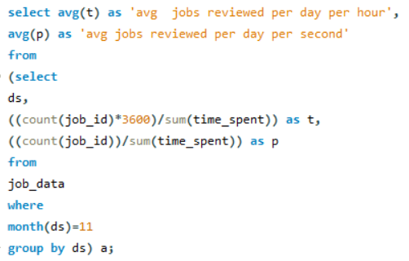

INSIGHTS:
CASE STUDY 1
A) Jobs Reviewed Over Time:
TASK 1: Write an SQL query to calculate the number of jobs reviewed per hour for each day in November 2020.
Therefore approx. 127 jobs were reviewed per hour for each day in November 2020.

Slide 7
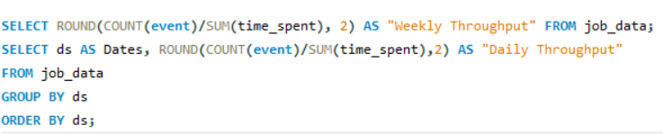
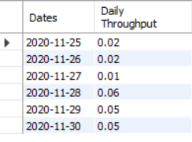
B) Throughput Analysis:
Task 2 : Write an SQL query to calculate the 7-day rolling average of throughput. Additionally, explain whether you prefer using the daily metric or the 7-day rolling average for throughput, and why.
We refer to the 7-day rolling average for throughput because it provides a smoother, more stable view of throughput trends over time, helping to smooth out short-term fluctuations and provide a clearer picture of the overall trend. It is useful for long-term analysis and identifying underlying patterns in throughput behavior.

Slide 8
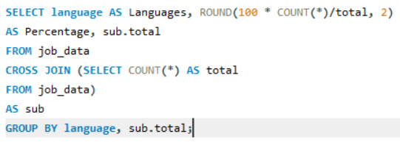
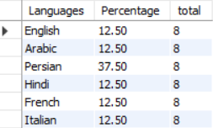
C) Language Share Analysis:
Task 3 : Write an SQL query to calculate the percentage share of each language over the last 30 days.
As given in the output/insight Persian language has the highest percentage share ie 37.50% and Italian,Emglish,Arabic,Hindi,French has the lowest percentage share ie 12.50% over the last 30 days.

Slide 9


D) Duplicate Rows Detection:
Task 4 : Write an SQL query to display duplicate rows from the job_data table.
There is a duplicate row with id 1003 which has 2 duplicates.

Slide 10
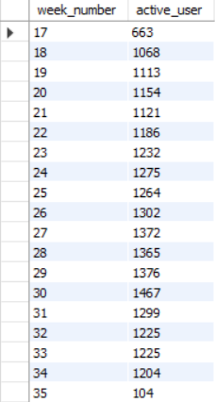
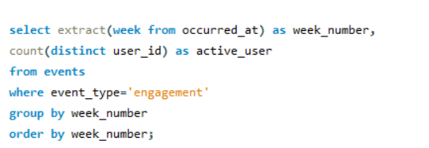
INSIGHTS:
CASE STUDY 2
A) Weekly User Engagement:
TASK 1: Write an SQL query to calculate the weekly user engagement.
1 ) Highest user week : week 30
2) Lowest user week : week 35

Slide 11
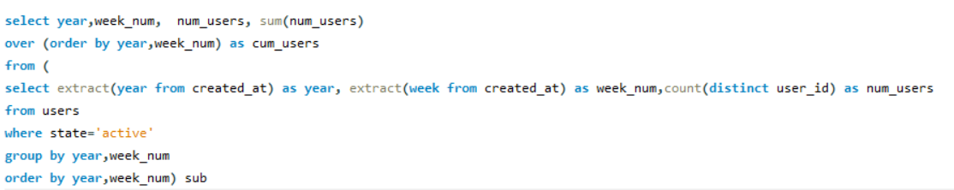
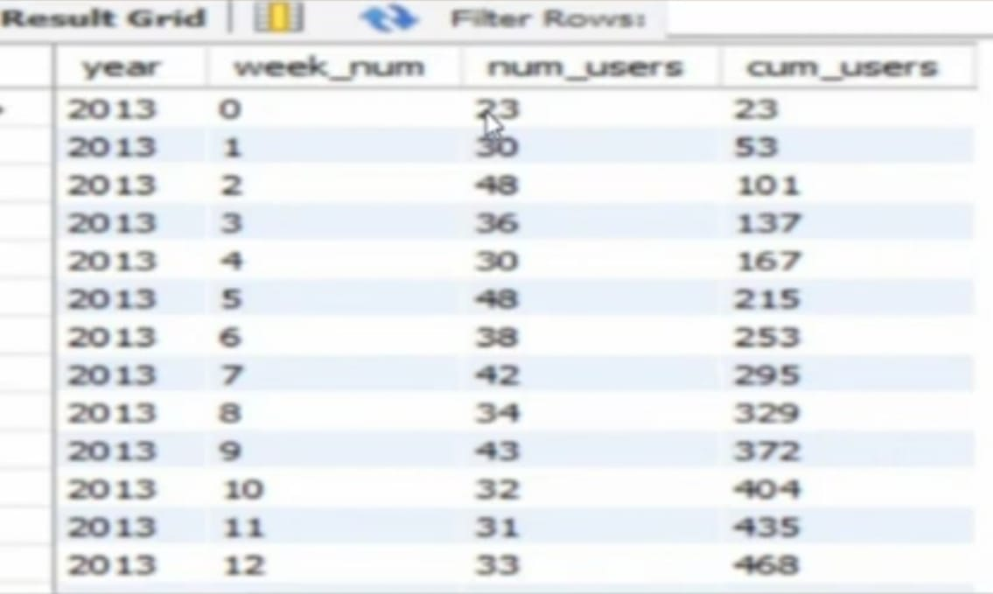
B) User Growth Analysis:
Task 2 : Write an SQL query to calculate the user growth for the product.
The 12th week 2013 has the highest user growth for the product ie 468 and the lowest week is 0 with 23 users only.

Slide 12
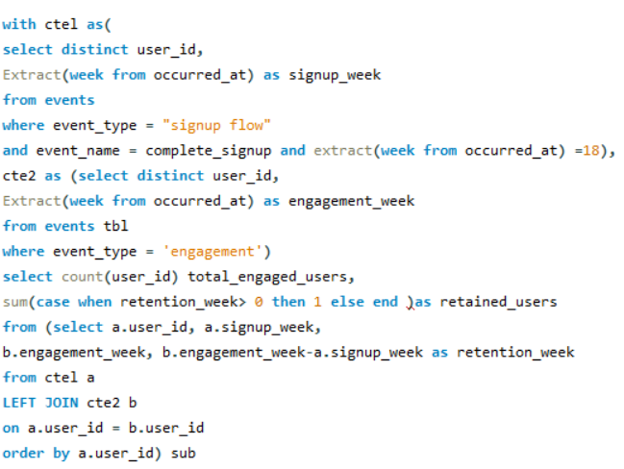

C) Weekly Retention Analysis :
Task 3 : Write an SQL query to calculate the weekly retention of users based on their sign-up cohort.
Total 236 users were retained out of 317 on an average weely on their sign-up cohort.

Slide 13
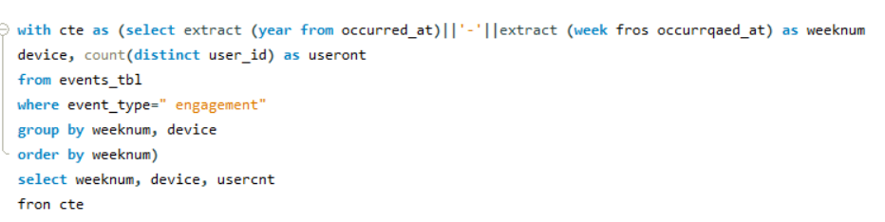
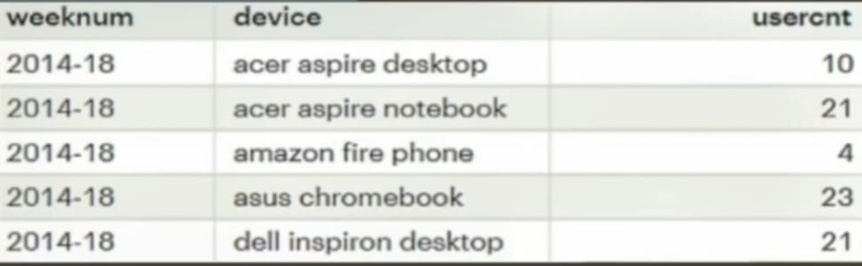
D) Weekly Engagement Per Device :
Task 4 : Write an SQL query to calculate the weekly engagement per device.
Therefore , during 2014-18 weekly engagement per device is highest for asus chromebookfor 23 users on average.

Slide 14
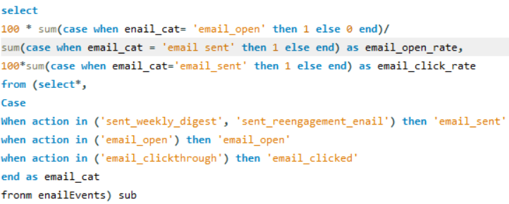
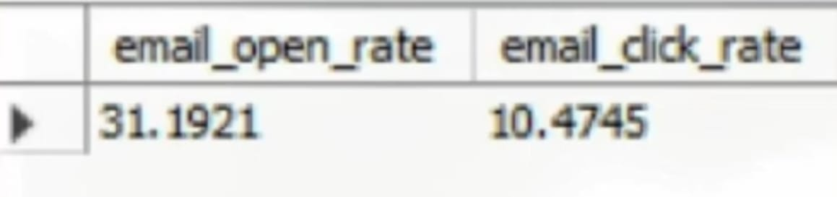
E) Email Engagement Analysis:
Task 5 : Write an SQL query to calculate the email engagement metrics.
There were 31.1921 email open rate with 10.4745 email click rate on average.

Slide 15
RESULTS :
In the Operational Analytics project, various aspects of the company's operations are analyzed using SQL queries. Here is a summary of the main tasks and their results. These findings provide valuable insights into user behavior, engagement patterns and areas for business improvement:
Offers reviewed over time: 0.01 jobs were reviewed every hour in November.
Performance analysis: 7 day moving average is best for performance analysis.
Analysis of Language Type: The percentage of Persian was the highest among other languages.
Email Engagement Analysis: About 35.73% of all emails sent were opened and only 10.74% of those emails were clicked.
Weekly User Engagement: Weekly user engagement is highest in week 31.
User Growth Analysis: Weeks 33 and 35 of 2014 were the highest and lowest weeks of user activity.
Weekly Retention Analysis: The maximum number of retained users was maintained only for one week and the retention rate decreased.
Weekly engagement by device: users who were most engaged with the product used a Asus Chromebook.

Slide 16
CONCLUSION:
Identifying evaluated activities and sharing language can provide important information about user needs and behaviors, companies can offer more customizable services.
Retention rates calculation highlights the importance of user engagement and the need to implement strategies to retain users over the long term.
SQL can be a great opportunity for analysts, because it is data-driven. It was identified as one of the most important skills for a person in the position.
They help improve day-to-day operations, optimize user experience and increase business sales by providing actionable insights and maintaining agility and responsiveness in a dynamic business environment. This project provided a comprehensive understanding of several factors important to long-term business growth and success.
This highlighted the importance of data analytics and the role of key data analysts in driving business growth and ensuring market competitiveness.

Slide 17
THANK YOU!!!

